Slide 1
Family Assessment Part II The IPscope Framework for Systemic Assessment
13 September 2023
by Karl Tomm MD
University of Calgary

Slide 2
Questions
Where are moods located? Interpersonal space? Personal space? Household space? Community space? If moods are dynamic limbic generations of each person’s affective experiences, then we need to locate the dynamics of affective experiences.

Slide 3
Why use models or theories?
Most therapists draw heavily upon their intuitive personal knowledge about relationships in doing therapy.
However, a good theory helps to organize ourselves more carefully in relation to any particular phenomenon or situation.
As family therapists, we benefit from various theories that help orient us in our efforts to be helpful with families in crisis.
There are many, many theories and models in our field; and some are more useful than others.
At the Calgary Family Therapy Centre we have found a model of an 'IPscope' to be especially helpful for students and professionals learning to become more systemic in their understandings and in their work doing family therapy.

Slide 4
A sampling of models to assess families
In day-to-day talk, people occasionally refer to a family as 'dysfunctional' (which implies a colloquial assumption that other families are 'functional').
Salvador Minuchin distinguished between enmeshed vs disengaged families.
The MRI distinguished between schizophrenogenic vs depressogenic families.
David Reiss contrasted environment sensitive vs consensus sensitive families.
Bob Beavers’ systems model entailed centripetal, centrifugal, and mixed patterns.
David Olson developed a circumplex model of family assessment with two dimensions: closeness vs distance, and flexibility vs rigidity.
The Calgary IPscope framework focusses on interpersonal patterns of interaction.

Slide 5
What exactly is the ‘IPscope’?
The ‘IPscope’ is a cognitive instrument, for distinguishing and describing specific Interpersonal Patterns of interaction for systemic assessment. It draws upon both perceptual and conceptual skills in the observer.
By definition, Interpersonal Patterns, or ‘IPs’ are repetitive or recurrent interactions between two or more persons, that constitute a transient but important component of the overall relationship between those persons.
IPs may be distinguished by a systemic observer or systemic therapist by highlighting the coupling between two classes of behaviors, cognitions or emotions, that tend to be mutually enabling and/or mutually reinforcing.
The suffix ‘scope’ in the IPscope is intended to draw an analogy with other human-made instruments which "help observers see" that which is ordinarily hard for the naked eye to see (cf. a microscope or a telescope).

Slide 6
A figure/ground gestalt shift
Notes:
-Most of us are socialized to perceive and understand other persons as separate individuals.
-Becomes difficult to work within a relational perspective where the focus shifts from seeing problems and their solutions as located within individuals to understanding them as relational patterns in the interpersonal space
-We understand this shift as a figure/ground Gestalt shift…Key to this type of shift is the notion that perception is relative not absolute.
Perception results from the comparison between a figure and a ground. Eg. Boiled egg.
What ends up being the figure (what we give priority to or focus on) depends on how we perceive the world at that point.
Figure: Depending on the person’s focus…
We can will ourselves to see either, however, not as easy with perceptual movement between individual or relational perspective.
Two faces (indivudual) vase (the relationship between the two) because of our socialization and training most will see the individual faces rather than the shape of the vase (the relationship between them).
Need a proactive tool to make the gestalt shift to see this relational perspective – IPscope lens paired with a number of different learning activities we utilize at CFTC
Goal is to be work from either or stance in a complementary manner.

Slide 7
What is the behavioral shape and emotional tone of the interpersonal space in this family system?
Notes:
-Most of us are socialized to perceive and understand other persons as separate individuals.
-Becomes difficult to work within a relational perspective where the focus shifts from seeing problems and their solutions as located within individuals to understanding them as relational patterns in the interpersonal space
-We understand this shift as a figure/ground Gestalt shift…Key to this type of shift is the notion that perception is relative not absolute.
Perception results from the comparison between a figure and a ground. Eg. Boiled egg.
What ends up being the figure (what we give priority to or focus on) depends on how we perceive the world at that point.
Figure: Depending on the person’s focus…
We can will ourselves to see either, however, not as easy with perceptual movement between individual or relational perspective.
Two faces (indivudual) vase (the relationship between the two) because of our socialization and training most will see the individual faces rather than the shape of the vase (the relationship between them).
Need a proactive tool to make the gestalt shift to see this relational perspective – IPscope lens paired with a number of different learning activities we utilize at CFTC
Goal is to be work from either or stance in a complementary manner.

Slide 8
Some relevant concepts from Systems Theory
Systems are composites, that is, they are always made up of component parts.
“A change in any one part triggers change in every other part” of the system.
“The whole (system) is greater than the sum of its parts.”
Systems may be analyzed at different levels and in different domains where different phenomena arise.
Living organisms as systems are characterized by homeostasis and autonomy.
Human relationship systems are characterized by recurrent, reciprocal, or ‘circular’ interactions.

Slide 9
Notes:
Complete animated slide:Animation order: 1)red arrows 2)green star 3) blue arrows 4) inner drawings

Slide 10
Notes:
Complete animated slide:Animation order: 1)red arrows 2)green star 3) blue arrows 4) inner drawings

Slide 11
Notes:
Complete animated slide:Animation order: 1)red arrows 2)green star 3) blue arrows 4) inner drawings

Slide 12
Notes:
Complete animated slide:Animation order: 1)red arrows 2)green star 3) blue arrows 4) inner drawings

Slide 13
Some relevant concepts from Bringforthism
Humberto Maturana’s specific theory of knowledge provides an explanation of how we as human beings come to know what we know.
In our living, we interact within our niche and 'bring forth' entities by drawing distinctions in our cognition.
Once distinguished, an entity can be seen as interacting with other entities, including with oneself.
The result of any interaction is always determined by the structures of the entities interacting (structure determinism).
‘Structural coupling’ occurs when ongoing interactions between 2 or more entities become stabilized through 'mutual invitations' that have become habitual.
The coupling then presents as a pattern within the relationship.

Slide 14
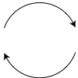
The IPscope employs simple graphic diagrams to clarify the coupling of behaviors distinguished in the patterns
The circularity of the graphic implies a pattern of interaction that repeats itself again and again, and which reflects an important aspect of an ongoing relationship.
Succinct text describes observable behaviors distinguished in the pattern (using gerunds).
The arched arrows imply ‘invitations’ that are mutual and recur (the arrows should not be regarded as lineal, deterministic or causal connections).
The slash in the center implies reciprocity in the ‘structural coupling’ of the behaviors that occur in the interpersonal space.
talking
listening

Slide 15
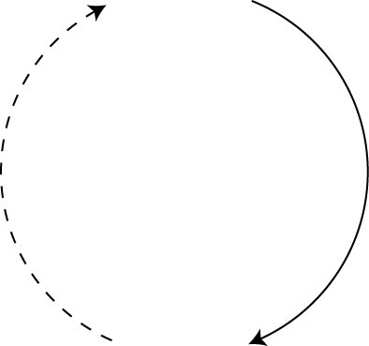
The diagram reflects a 'distillate' of recurrent interactions which foreground the coupling of the behaviors that are distinguished in the pattern
pressuring
suggesting
responding
resisting
Patterns drawn vertically imply a significant
power differential between the relevant behaviors

Slide 16
Several components of the ‘IPscope’
The framework entails a typology of at least 7 kinds of IPs
which may be grouped in three clusters:
WIPs = Wellness Interpersonal Patterns
PIPs = Pathologizing Interpersonal Patterns
HIPs = Healing Interpersonal Patterns
TIPs = Transforming Interpersonal Patterns
DIPs = Deteriorating Interpersonal Patterns
SCIPs = Socio-Cultural Influencing Patterns
SNIPs = Social Network Interactional Patterns
Core
patterns
Transition
patterns
External
patterns

Slide 17
A ‘WIP’ or Wellness Interpersonal Pattern is defined as a recurrent interpersonal interaction that enables generativity, competence, and/or effectiveness of one or both participants and/or that sustains or enhances health in the relationship.
Sample WIP-1
speaking
listening

Slide 18
A ‘WIP’ or Wellness Interpersonal Pattern is defined as a recurrent interpersonal interaction that enables generativity, competence, and/or effectiveness of one or both participants and/or that sustains or enhances health in the relationship.
Sample WIP-2
acknowledging
the other
acknowledging the
acknowledgement

Slide 19
A ‘WIP’ or Wellness Interpersonal Pattern is defined as a recurrent interpersonal interaction that enables generativity, competence, and/or effectiveness of one or both participants and/or that sustains or enhances health in the relationship.
Sample WIP-3
giving affection and
providing care
accepting affection
and appreciating care

Slide 20
A ‘WIP’ or Wellness Interpersonal Pattern is defined as a recurrent interpersonal interaction that enables generativity, competence, and/or effectiveness of one or both participants and/or that sustains or enhances health in the relationship.
Sample WIP-4
setting limits and
maintaining boundaries
accepting limits and
respecting boundaries

Slide 21
A ‘WIP’ or Wellness Interpersonal Pattern is defined as a recurrent interpersonal interaction that enables generativity, competence, and/or effectiveness of one or both participants and/or that sustains or enhances health in the relationship.
Sample WIP-5
offering
constructive feedback
learning
from mistakes

Slide 22
A ‘PIP’ or Pathologizing Interpersonal Pattern is defined as a recurrent interpersonal interaction which activates or increases negativity, pain and/or suffering in one or both persons interacting, or which results in deterioration of the relationship.
Sample PIP-1
criticizing
defending

Slide 23
A ‘PIP’ or Pathologizing Interpersonal Pattern is defined as a recurrent interpersonal interaction which activates or increases negativity, pain and/or suffering in one or both persons interacting, or which results in deterioration of the relationship.
Sample PIP-2
judging
protesting

Slide 24
A ‘PIP’ or Pathologizing Interpersonal Pattern is defined as a recurrent interpersonal interaction which activates or increases negativity, pain and/or suffering in one or both persons interacting, or which results in deterioration of the relationship.
Sample PIP-3
condemning
evading

Slide 25
A ‘PIP’ or Pathologizing Interpersonal Pattern is defined as a recurrent interpersonal interaction which activates or increases negativity, pain and/or suffering in one or both persons interacting, or which results in deterioration of the relationship.
Sample PIP-4
frustrated
pursuing
fearful
distancing

Slide 26
A ‘PIP’ or Pathologizing Interpersonal Pattern is defined as a recurrent interpersonal interaction which activates or increases negativity, pain and/or suffering in one or both persons interacting, or which results in deterioration of the relationship.
Sample PIP-5
onus putting
onus taking

Slide 27
A ‘HIP’ or Healing Interpersonal Pattern is a sub-category of a WIP that constitutes a specific antidote to a particular PIP by bringing forth positive behaviors and/or experiences in one or both of the interactants that specifically preclude or contradict some component of the PIP.
Sample HIP-1
selective noticing
of competence
enactng
more competence

Slide 28
A ‘HIP’ or Healing Interpersonal Pattern is a sub-category of a WIP that constitutes a specific antidote to a particular PIP by bringing forth positive behaviors and/or experiences in one or both of the interactants that specifically preclude or contradict some component of the PIP.
Sample HIP-2
apologizing
forgiving

Slide 29
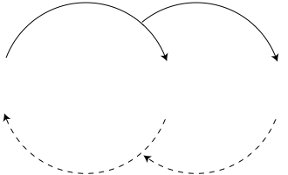
Movement among the IPs within an overall
interpersonal relationship system
TIPs
Transforming
Interpersonal
Patterns
HIPs
&
WIPs
PIPs
Pathologizing
Interpersonal
Patterns
Healing
Interpersonal
Patterns
Wellness
Interpersonal
Patterns
Clinical families tend to get stuck in PIPs;
Healthy families spend more time living in WIPs
Notes:
TIP/PIP/WIP etc.

Slide 30
A ‘TIP’ or Transforming Interpersonal Pattern is also a sub-category of a WIP, which could enable movement away from a PIP or towards a HIP or WIP.
Sample TIP - 1
asking about
concerns
disclosing
concerns
A clarifying conversation

Slide 31
A ‘TIP’ or Transforming Interpersonal Pattern is also a sub-category of a WIP, which could enable movement away from a PIP or towards a HIP or WIP.
Sample TIP - 2
Enquiring about the systemic nature and origin of problems
Disclosing the relational
nature and origin of problems
Example of a de-constructive TIP

Slide 32
A ‘TIP’ or Transforming Interpersonal Pattern is also a sub-category of a WIP, which could enable movement away from a PIP or towards a HIP or WIP.
Sample TIP - 3
Asking reflexive questions to
open space for possibilities
Distinguishing new possibilities and considering new initiatives
Example of a co-constructive TIP

Slide 33
A ‘TIP’ or Transforming Interpersonal Pattern is also a sub-category of a WIP, which could enable movement away from a PIP or towards a HIP or WIP.
Sample TIP - 4
Asking about helpful
variations in the PIP
Identifying HIP-like aspects of the PIP
Example of a utilization TIP

Slide 34
TIPs utilizing aspects of a PIP to invite a WIP/HIP
criticizing
defending
In what way could
the criticizing
be helpful?
When has
the defending
been useful?
learning from
mistakes
providing
useful feedback
self protective
protesting
relinquishing
unfair criticism

Slide 35
Location of DIPs within the overall
interpersonal relationship system
TIPs
Transforming
Interpersonal
Patterns
HIPs
&
WIPs
PIPs
Pathologizing
Interpersonal
Patterns
Healing
Interpersonal
Patterns
Wellness
Interpersonal
Patterns
Deteriorating
Interpersonal
Patterns
DIPs
Notes:
TIP/PIP/WIP etc.

Slide 36
A ‘DIP’ or Deteriorating Interpersonal Pattern is a sub-category of a PIP, that creates conditions for a probable slip from a TIP, HIP, or WIP, towards a PIP.
Sample DIP-1
scrutinizing
performance
self-conscious
performing

Slide 37
A ‘DIP’ or Deteriorating Interpersonal Pattern is a sub-category of a PIP, that creates conditions for a probable slip from a TIP, HIP, or WIP, towards a PIP.
Sample DIP-2
seeking attention
ignoring

Slide 38
A ‘DIP’ or Deteriorating Interpersonal Pattern is a sub-category of a PIP, that creates conditions for a probable slip from a TIP, HIP, or WIP, towards a PIP.
Sample DIP-3
pursuing
distancing

Slide 39
A ‘DIP’ or Deteriorating Interpersonal Pattern is a sub-category of a PIP, that creates conditions for a probable slip from a TIP, HIP, or WIP, towards a PIP.
Sample DIP-4
reminding
procrastinating

Slide 40
A ‘DIP’ or Deteriorating Interpersonal Pattern is a sub-category of a PIP, that creates conditions for a probable slip from a TIP, HIP, or WIP, towards a PIP.
Sample DIP-5
nagging
resisting
This pattern can easily become a major PIP.

Slide 41
Depending on the intensity of a Deteriorating Pattern (DIP),
it can easily become a full-blown Pathologizing Pattern (PIP)
pressuring and
threatening
rebelling and
acting out

Slide 42
Summary of movements among the core IPs within an
overall interpersonal relationship system
TIPs
Transforming
Interpersonal
Patterns
HIPs
&
WIPs
PIPs
Pathologizing
Interpersonal
Patterns
Healing
Interpersonal
Patterns
Wellness
Interpersonal
Patterns
Deteriorating
Interpersonal
Patterns
DIPs
Notes:
TIP/PIP/WIP etc.

Slide 43
An example of a basic IPscopic Reflectogram
enquiring
reflecting
TIP
WIP
pressuring
resisting
affirming
risking
PIPs
HIPs
honoring
autonomy
expressing
self freely
disapproving
dissociating
encouraging
open anger
discharging
anger freely
DIP
IP gazing
shutting down
Notes:
TIP/PIP/WIP etc.

Slide 44
The influence of larger social systems
Societal beliefs shaping individuals and families
Practices of individuals and families shaping Society

Slide 45
A ‘SCIP’ or Socio-Cultural Influencing Pattern describes how social discourses, values, and/or beliefs in our culture are taken up and enacted by family members; who through their enactment of the pattern reinforce and/or re-inscribe the discourse or pattern in our community or culture.
Sample SCIP-1
patriarchal beliefs about male entitlement and privilege
male family members exercising dominance over female members
Pathology, PSCIP?

Slide 46
An egalitarian ‘SCIP’ could serve as a HIP-ish antidote to the patriarchal SCIP of male dominance, or it could create conditions for confusion and conflict about roles and responsibilities. Thus, it could have either positive or negative effects, depending on how it is enacted and experienced.
Sample SCIP-2
egalitarian beliefs
about gender relations
males and females sharing power equally

Slide 47
Where would one locate SCIPs within the overall
interpersonal relationship system?
TIPs
Transforming
Interpersonal
Patterns
HIPs
&
WIPs
PIPs
Pathologizing
Interpersonal
Patterns
Healing
Interpersonal
Patterns
Wellness
Interpersonal
Patterns
Deteriorating
Interpersonal
Patterns
DIPs
Notes:
TIP/PIP/WIP etc.

Slide 48
Where would one locate SCIPs within the overall
interpersonal relationship system? All over!
SCIPs
SCIPs
TIPs
Transforming
Interpersonal
Patterns
HIPs
&
WIPs
PIPs
Pathologizing
Interpersonal
Patterns
Healing
Interpersonal
Patterns
Wellness
Interpersonal
Patterns
Deteriorating
Interpersonal
Patterns
SCIPs
DIPs
SCIPs
Notes:
TIP/PIP/WIP etc.

Slide 49
Where might one locate the specific sexist and egalitarian SCIPs
within the overall interpersonal relationship system?
Egalitarian
SCIP
TIPs
Transforming
Interpersonal
Patterns
HIPs
&
WIPs
PIPs
Pathologizing
Interpersonal
Patterns
Healing
Interpersonal
Patterns
Wellness
Interpersonal
Patterns
Deteriorating
Interpersonal
Patterns
Sexist SCIP
DIPs
Notes:
TIP/PIP/WIP etc.

Slide 50
A ‘SNIP’ or Social Network Interaction Pattern describes how a person, or small collective of persons, outside the family system interacts with one or more members of the family in ways that influence the patterns of interaction inside the family. These influences can be positive or negative depending on the circumstances and the nature of the interaction.
A generic SNIP
Extended family, friends, peers, neighbors, & professionals making relational comments
Family members taking up and
using relational suggestions of outsiders

Slide 51
A ‘SNIP’ or Social Network Interaction Pattern describes how a person, or small collective of persons, outside the family system interacts with one or more members of the family in ways that influence the patterns of interaction inside the family. Usually these influences are positive and actively support the wellbeing of the family.
WIPish SNIP
Friends and peers offering support and encouraging respectful relations
Families embracing helpful comments
and enacting preferred familial relations

Slide 52
A ‘SNIP’ or Social Network Interaction Pattern describes how a person, or small collective of persons, outside the family system interacts with one or more members of the family in ways that influence the patterns of interaction inside the family. Usually these influences are positive and actively support the wellbeing of the family.
HIPish SNIP
Therapist encouraging parents to
offer empathy to a troubled child
Parents attuning more to child and seeking further guidance

Slide 53
A ‘SNIP’ or Social Network Interaction Pattern describes how a person, or small collective of persons, outside the family system interacts with one or more members of the family in ways that influence the patterns of interaction inside the family. Sometimes the SNIP influences can be very negative and undermine the wellbeing of the family.
PIPish SNIP-1
A teacher complaining to parents about misbehavior of the child
Parents pressuring the child
and activating its misbehavior

Slide 54
A ‘SNIP’ or Social Network Interaction Pattern describes how a person, or small collective of persons, outside the family system interacts with one or more members of the family in ways that influence the patterns of interaction inside the family. Sometimes the SNIP influences can be very negative and undermine the wellbeing of the family.
PIPish SNIP-2
A lawyer advising a separated parent to go after disproportionate custody
The parent insisting on more concessions from the other co-parent

Slide 55
Where would one locate a SNIP within the overall
interpersonal relationship system?
Also all over!
SNIPs
SNIPs
TIPs
Transforming
Interpersonal
Patterns
HIPs
&
WIPs
PIPs
Pathologizing
Interpersonal
Patterns
Healing
Interpersonal
Patterns
Wellness
Interpersonal
Patterns
Deteriorating
Interpersonal
Patterns
SNIPs
SNIPs
DIPs
Notes:
TIP/PIP/WIP etc.

Slide 56
Where might one locate the specific examples of SNIPs
in the overall interpersonal relationship system?
Therapist
SNIP
Generic
SNIP
TIPs
Transforming
Interpersonal
Patterns
HIPs
&
WIPs
PIPs
Pathologizing
Interpersonal
Patterns
Healing
Interpersonal
Patterns
Wellness
Interpersonal
Patterns
Deteriorating
Interpersonal
Patterns
Lawyer SNIP
DIPs
Teacher SNIP
Notes:
TIP/PIP/WIP etc.

Slide 57
Drawing a full IPscopic Reflectogram requires deliberate reflection upon systemic patterns and their connectedness
and could provide a map to orient the therapy process
SCIPs &
SNIPs
SCIPs &
SNIPs
TIPs
PIPs
HIPs
WIPs
DIPs
SCIPs &
SNIPs
SCIPs &
SNIPs
Notes:
TIP/PIP/WIP etc.

Slide 58
A full IPscopic Reflectogram for a client's relational assessment
WIPish
SCIPs
therapists
may have
good ideas
cultural
values that
enhance
WIPish
SNIP
friends
supporting
parents
sharing
enquiring
reflecting
TIP
WIP
pressuring
resisting
affirming
risking
PIPs
HIPs
honoring
autonomy
expressing
self freely
disapproving
dissociating
encouraging
open anger
discharging
anger freely
DIP
PIPish
SCIPs
cultural
demands for
harmony
children
ought to
obey
PIPish
SNIP
IP gazing
shutting down
friends
excluding
seeking
revenge
Notes:
TIP/PIP/WIP etc.

Slide 59
Important features of the ‘IPscope’
IPs describe transient relational stabilities. They are constituted by joint actions where patterns are created mutually. These interaction patterns are always changing and are never permanent. However, when they are active, they profoundly influence the participants' moment-to-moment experience.
IPs do not have a physical existence. They exist in the imagination of systemic observers. They are cognitive constructions that may be regarded as ‘serviceable fictions’ in that they serve to guide the initiatives of systemic therapists but are not necessarily ‘objective’ or ‘real.’ Their existence depends on the distinctions drawn by a systemic observer.
To limit the possibility of excessive exuberance in an observer’s imagination (e.g. to construct just anything), IPs are usually described in behavioral terms using gerunds (i.e. action-words ending in ‘-ing’ such as criticizing or withdrawing) which help ground the patterns in observable transactions.

Slide 60
Important features of the ‘IPscope’ (cont’d)
An important conceptual skill that helps therapists distinguish IPs is to learn to ‘collapse time’ in order to render the circularity of a pattern more visible. Sequential turn-taking may render the circularity as quite apparent, while remote responsiveness may leave the coupling quite difficult to identify.
A second conceptual skill that helps construct IPs is to selectively bring forth complementarity in the coupling between specific behaviors of participants.
A third conceptual skill is to externalize the behaviors from the persons enacting them and to locate their coupling in the interpersonal space.
A fourth skill is to recognize the recurrent and habitual nature of IPs. Sequences of interaction are stored in memory, which render them ‘familiar.’ The familiarity of any particular pattern predisposes the persons involved to re-enact that pattern, regardless whether the pattern is conscious or not; desirable or not.

Slide 61
Important features of the ‘IPscope’ (cont’d)
Participation in DIPs and PIPs is obviously undesirable. In CMM theory they are URPs (Undesirable Repetitive Patterns). What is noteworthy is that participating in such recurrent problematic coupling is mostly nonconscious: 'logical forces' of communication compel the participants to continue.
Needless-to-say, participation in ongoing WIPs is very desirable. However, active involvement in WIPs is also usually nonconscious.
Initiating HIPs is usually very helpful when PIPs are dominant but doing so often requires some deliberate conscious effort to improve a relationship. Clinical families may require some guidance and support from therapists to generate and/or realize their HIPs.
TIPs may arise spontaneously in families. Clinical families typically benefit from initiatives by systemic therapists who enact TIPs.

Slide 62
Important features of the ‘IPscope’ (cont’d)
Pattern recognition offers economy in cognition and is widespread among most living systems. If one component of a pattern is identified, other components may be inferred and selected out from a huge background of interactive 'noise'.
If a particular behavior happens only once and doesn't occur again it is probably not that significant (unless it is taken into memory where it could recur). It is when the behavior becomes coupled with other behaviors in a pattern that it becomes more significant.
For instance, if a young child in a tantrum yells at his father "I'll kill you!" it may simply be forgotten and fall away, but if a father in a fit of rage yells at his son "I'll kill you!" the son may remember the incident and the anger could become coupled with fear in a pattern that recurs and contributes to the son's reactivity in other relationships.

Slide 63
Important features of the ‘IPscope’ (cont’d)
It is usually possible to distinguish 2 or 3 core PIPs in a clinical family where the patterns become 'rutted', and the family slips into them again and again.
I sometimes draw one or more of these PIPs on a chalkboard to help the family recognize them more clearly.
I then often engage family members to collaborate in identifying possible wellness patterns (HIPs and WIPs) that could displace the core PIPs.
In this way family members' conscious awareness of the different patterns could become a potential resource in their deliberate efforts to move towards more healing and wellness.

Slide 64
Deconstructing DSM diagnoses into PIPs
Human mental phenomena, including thoughts, feelings, intentions, actions, and consciousness itself, may be seen to arise through processes of social interaction.
Both Gregory Bateson and Humberto Maturana made the claim that “the Mind is first and foremost social, and secondarily psychological”
For instance, language is not in the brain (even though it depends on the neuroplasticity of the brain); language is among us, we are immersed in it, internalize it, and use it to give meaning to experience.
If this notion of the social origination of mental phenomena is valid, then it should be possible (theoretically at least) to deconstruct an individual 'mental illness’ into patterns of social interaction.
My colleagues and I have tried to identify specific interaction patterns or IPs that generate and/or aggravate particular mental disorders.
In doing so, we appear to be 'going against the grain' with respect to contemporary developments in psychiatry and mental health.

Slide 65
What are some common PIPs associated with
clinical ‘depression’
and some possible social antidotes?

Slide 66
PIP
blaming and
diminishing the other
blaming and
diminishing the self
HIP
affirming and
crediting the other
affirming and
crediting the self

Slide 67
PIP
excluding the other
isolating the self
HIP
proactively including
the other
responding and
participating

Slide 68
PIP
suppressing the open expression of anger
turning one’s anger
inward against the self
HIP
encouraging and validating the outward expression of anger
taking risks in releasing anger, rage, and outrage

Slide 69
Depression as a manifestation of oppression
PIP
dominating with
oppressive practices
submitting with
depressive practices
HIP
relinquishing practices of imposition
protesting unfair
impositional practices

Slide 70
What are some common PIPs associated with
‘anxiety’ along with some possible HIPs?

Slide 71
PIP
Threatening and/or demeaning the other
Withdrawing and avoiding the abuse
HIP
Acknowledging unfairness and expressing regret
Collecting support and holding others accountable

Slide 72
PIP
Imposing and demanding submission/compliance
Conceding to the demands of the other
HIP
Relinquishing demands and encouraging protest
Expressing outrage & asserting personal agency

Slide 73
What are some common PIPs associated with
‘psychosis’ and some possible social antidotes?

Slide 74
PIP
invalidating and/or
disqualifying the other
manifesting bizarre
thoughts and behavior
HIP
validating the other’s unusual experiences
disclosing more of
one’s inner experiences

Slide 75
PIP
judging, demeaning, avoiding, excluding, and ostracizing
coordinating less and showing
less acceptable thoughts and behavior
HIP
proactively accepting,
engaging, and including
coupling more with consensual thoughts, behavior, and values

Slide 76
What is a common PIP often found with
‘paranoia’
and a possible healing antidote?

Slide 77
PIP
withholding
information
reacting
with suspicion
HIP
open sharing of
information
active
questioning

Slide 78
What are some common PIPs associated with
‘lying and stealing’
along with some healing antidotes?

Slide 79
PIP
judgmental
condemning
deceptive
evading
HIP
accepting inner
struggles
disclosing
temptations

Slide 80
PIP
demanding honest disclosure
and threatening punishment
withholding the truth
and telling plausible stories
HIP
selectively noticing and
honoring honest admissions
admitting to mistakes and/or lies and expressing regret

Slide 81
Do parents inadvertently limit their
children's learning from their mistakes?
If so, what might the pathologizing
interaction pattern (PIP) look like?

Slide 82
PIP
protecting child from natural consequences of its mistakes
failing to learn with
continuing vulnerability
HIP
allowing child to face the consequences of own mistakes
learning from the
consequences of own mistakes

Slide 83
Do parents inadvertently teach
their children sibling rivalry?
If so, what might the pathologizing
interaction pattern (PIP) look like?

Slide 84
PIP
parents claiming to treat the
children exactly the same
children searching for differences
and complaining about unfairness
HIP
parents treating each child as
different, unique, and special
children feeling more confidence in enacting their uniqueness

Slide 85
Do parents inadvertently aggravate their
adolescent's oppositionality?
If so, what might the pathologizing
interaction pattern (PIP) look like?

Slide 86
PIP
parents worrying and
imposing outer controls
adolescents resisting outer
control and rebelling
HIP-1
parents outlining alternatives and giving adolescents more options
adolescents experiencing choice
and exercising better inner control

Slide 87
PIP
parents worrying and
imposing outer controls
adolescents resisting outer
control and rebelling
HIP-2
parents acknowledging & relinquishing undue control
adolescents questioning limits
& protesting excessive control

Slide 88
What is a common PIP associated with
‘young adult entitlement syndrome’
along with a healing antidote?

Slide 89
PIP
parents accommodating to
adult child's demands
adult child threatening
violence or suicide
HIP-1
HIP-2
social network members supporting parents
parents announcing and
holding to firm boundaries
adult child responding to a changing ecology

Slide 90
Do couples inadvertently make it
more difficult to achieve intimacy?
If so, what might the pathologizing
interaction pattern (PIP) look like?

Slide 91
PIP
partner A pursing the other for more connection
partner B distancing for
autonomy about how to connect
HIP
partner A noticing when the
other is ready to respond
partner B appreciating sensitivity to readiness

Slide 92
Possible steps to construct a PIP
Intuit the strongest negative emotions that seem to be active within the main participants of the interaction.
Look for and distinguish observable behaviors (including spoken words) that reflect these negative emotions.
Imagine what these behaviors trigger in others who react strongly.
Sort out the specific behaviors of each interactant that appear to trigger a high level of reactivity from the other participant.
Select a generic or core behavior from each participant that appears to reinforce the negative behavior of the other.
Bring forth and highlight the coupling of these selected behaviors to produce a recurrent and circular pattern of interaction (using ‘gerund’ descriptors whenever possible).
Visualize the pattern in the interpersonal space and/or draw the pattern to give it sufficient ‘reality’ to work with.

Slide 93
Let’s apply the process: Imagine a couple in conflict seeking therapy

Slide 94
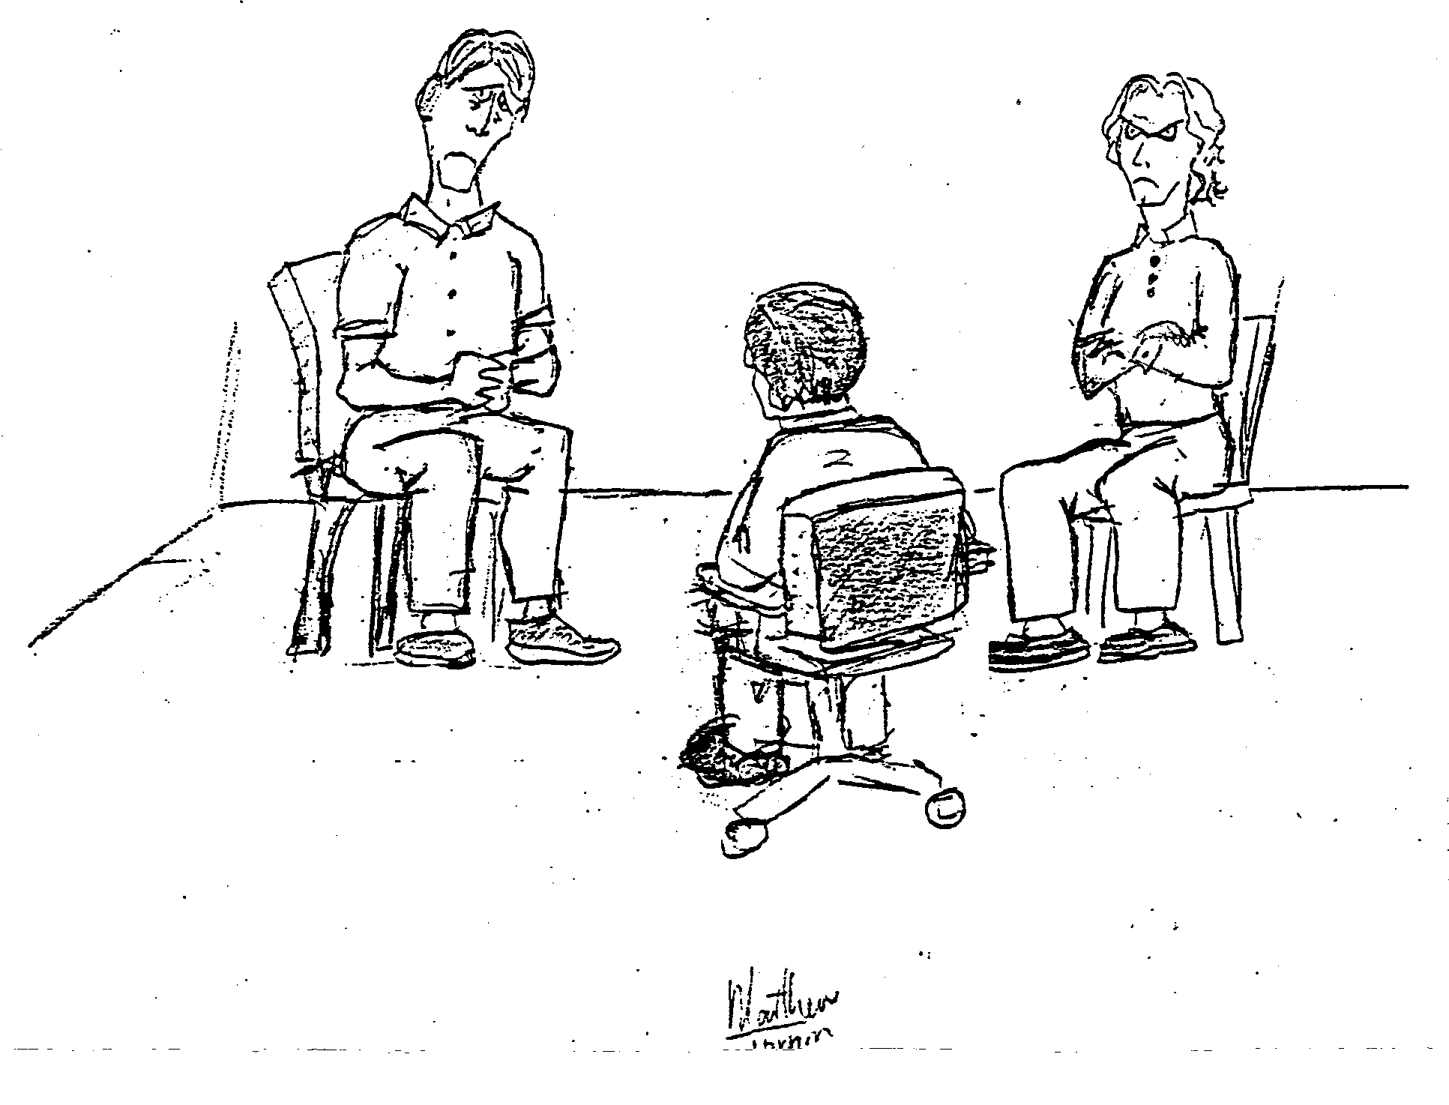
Intuit the dominant negative emotion in each participant

Slide 95
Intuit the dominant negative emotion in each participant
sadness
anger
Notes:
Complete animated slide:Animation order: 1)red arrows 2)green star 3) blue arrows 4) inner drawings

Slide 96
Identify observable behaviors that reflect those negative emotions

Slide 97
Identify observable behaviors that reflect those negative emotions
frowning face,
hunched over,
complaining
speech
scowling face,
crossed arms,
criticizing
speech
Notes:
Complete animated slide:Animation order: 1)red arrows 2)green star 3) blue arrows 4) inner drawings

Slide 98
Select out and highlight the coupling of behaviors
that produce a mutually reinforcing circular pattern
frowning face,
hunched over,
complaining
speech
scowling face,
crossed arms,
criticizing
speech

Slide 99
Select out and highlight the coupling of behaviors
that produce a mutually reinforcing circular pattern
complaining
criticizing

Slide 100
Visualize the pattern operating in the interpersonal space
complaining
criticizing

Slide 101
PIPs operate intra-personally as well as inter-personally
Notes:
Individual components of Slide 17

Slide 102
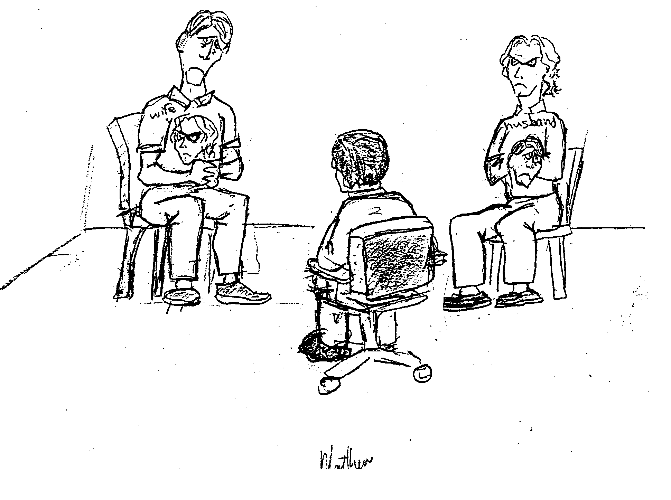
The ‘internalized other’ exists within each partner
complaining
criticizing
complaining
criticizing

Slide 103
The pattern is stabilized with both outer and inner components
complaining
criticizing
complaining
criticizing
complaining
criticizing

Slide 104
Possible steps to generate a HIP (to counter or displace a PIP)
Imagine and look for positive or constructive behaviors that would contradict, or are inconsistent with, specific behaviors within the PIP.
Take note of any spontaneous initiatives in the session that have the potential to displace the PIP, affirm them, and draw them out.
Select and support specific constructive behaviors that have the potential to become mutually reinforcing and could become coupled in the interpersonal space to stabilize a preferred interaction pattern.
Refine the descriptor terminology (using gerunds whenever possible) to reflect do-able behaviors for the participants in the interaction.
Visualize, describe, and/or draw the potential healing pattern to give it more substance and ‘reality.’
Ask specific questions to bring forth each of the complementary components of the HIP to help realize the preferred pattern.

Slide 105
PIP
complaining
criticizing
HIP-1
recognizing one’s own
self centeredness
using questions to hold the other accountable

Slide 106
PIP
complaining
criticizing
HIP-2
acknowledging the
other’s forbearance
appreciating the
awareness and recognition

Slide 107
PIP
complaining
criticizing
HIP-3
deliberately taking corrective action
honoring the
constructive initiatives

Slide 108
PIP
complaining
criticizing
HIP-4
apologizing
forgiving

Slide 109
This HIP potentially could be brought forth
through reflexive questioning
acknowledging
appreciating
Notes:
Individual components of Slide 17

Slide 110
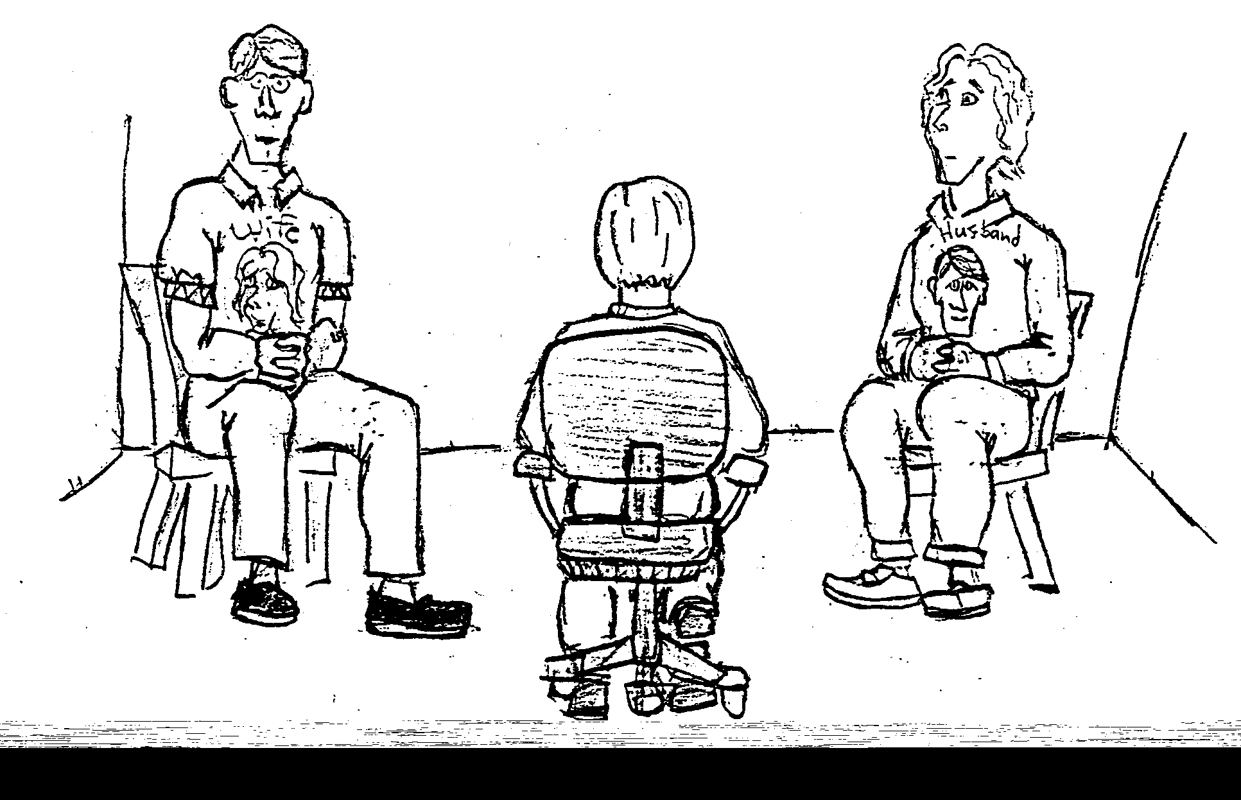
acknowledging
appreciating

Slide 111
The HIP could be stabilized if it operated
intra-personally as well as inter-personally
Notes:
Individual components of Slide 17

Slide 112
acknowledging
appreciating
acknowledging
appreciating
acknowledging
appreciating

Slide 113
Some limitations of the IPscope
It assumes relatively ‘normal’ biological functioning of the participants and overlooks limitations in the neuroplasticity of interacting brains.
The dyadic patterns are very basic and cannot begin to encompass the full complexity of multi-person family systems eg triadic interaction
To some, the patterns may seem too abstract and intellectual; for others too behavioral, obscuring the significance of emotional dynamics.
The drawings could be interpreted as concrete first order descriptions of interpersonal interaction and promote a drift toward objective ‘truth.’
There is a risk for users to become formulaic by applying ‘old’ patterns in their work (using ‘cook book’ IPs vs co-constructing unique IPs).
Excess enthusiasm in applying the framework could eclipse other useful descriptions of specific situations (the “Law of the Instrument”).
The feminist critique of systems theory as unsuitable as a foundation for family therapy (however this issue can be addressed).

Slide 114
What is the feminist critique of systems theory?
The circularity at the core of systemic descriptions of interaction implies equal influence and responsibility of the participants in generating and maintaining pathologizing patterns of interaction.
The assumption of equal influence obscures real differences in power between males and females that perpetuates conditions for the gender injustices that arise from such power differentials.
Thus, the use of systems theory to explain relationships in family systems could support this assumption of equal power and inadvertently enable continuing gender injustices.

Slide 115
criticizing
defending
criticizing
defending

Slide 116
blaming the other
blaming the self
blaming the other
blaming the self

Slide 117
What are some advantages in drawing IPs vertically?
The power differential between the participant behaviors is disclosed and becomes more apparent.
With WIPs (including HIPs and TIPs) the opportunity to take initiative and exercise more influence for constructive developments is highlighted.
With PIPs the hierarchy suggests a preferred point of entry for therapist initiatives to begin deconstructing a PIP, namely with the dominant behavioral component of the pattern.
Efforts by the disadvantaged party to unilaterally implement change in the pattern may trigger escalation of the PIP, especially when the dominant position confers some gains to the privileged party in the interaction.

Slide 118
A pervasive sexist PIP in our patriarchal culture
male
dominating
female
submitting

Slide 119
A relatively ‘safe’ process of change in sexism
exploring alternative masculinities
responding warmly to a preferred masculinity

Slide 120
A ‘risky’ process of change
experiencing insubordination and asserting more male authority
demanding more voice and taking personal authority

Slide 121
Males are not always dominant: females are
sometimes dominant, especially in certain domains
female
dominating
male
submitting

Slide 122
The dominating/submitting pattern
is ubiquitous in human relations
dominating
submitting
When this pattern is pervasive and persistent
it can become extremely toxic and pathologizing

Slide 123
A generic healing antidote to dominating/submitting
acknowledging one’s own privilege,
listening to the experiences of the other,
and redressing injustices
describing experiences of marginalization, claiming more voice, challenging unfairness, and/or assuming more privilege

Slide 124
References
Tomm, K. “Beginnings of a HIPs and PIPs Approach to Psychiatric Assessment” The Calgary Participator, p21-24, 1991
Tomm, K., St. George, S., Wulff, D., & Strong, T., Chapter 1 in Patterns in Interpersonal Interactions: Inviting Relational Understandings for Therapeutic Change, 2014 Routledge Press NY

